Slide 1



Slide 2
Course Outcomes
CO1: Characterize a system mathematically and find its steady state behaviour
CO2: Analyze stability of a system using different tests
CO3: Design various controllers
CO4: Solve linear, non-linear and optimal complex control problems
CO5: Designing state model for a given system of equations

Slide 3
Disclaimer
The contents used in this presentation are taken from the text books mentioned in the references. I do not hold any copyrights for the contents. It has been prepared to use in the class lectures, not for commercial purpose.

Slide 4

Syllabus

Slide 5
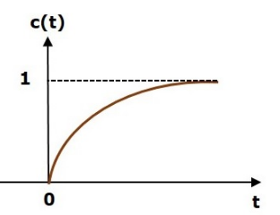
What is Stability?
A system is said to be stable, if its output is under control. Otherwise, it is said to be unstable. A stable system produces a bounded output for a given bounded input.
The following figure shows the response of a stable system.
This is the response of first order control system for unit step input. This response has the values between 0 and 1. So, it is bounded output. We know that the unit step signal has the value of one for all positive values of t including zero. So, it is bounded input. Therefore, the first order control system is stable since both the input and the output are bounded.

Slide 6
Types of Systems based on Stability
We can classify the systems based on stability as follows.
Absolutely stable system
Conditionally stable system
Marginally stable system
Absolutely Stable System
If the system is stable for all the range of system component values, then it is known as the absolutely stable system. The open loop control system is absolutely stable if all the poles of the open loop transfer function present in left half of ‘s’ plane. Similarly, the closed loop control system is absolutely stable if all the poles of the closed loop transfer function present in the left half of the ‘s’ plane.

Slide 7
Conditionally Stable System
If the system is stable for a certain range of system component values, then it is known as conditionally stable system.
Marginally Stable System
If the system is stable by producing an output signal with constant amplitude and constant frequency of oscillations for bounded input, then it is known as marginally stable system. The open loop control system is marginally stable if any two poles of the open loop transfer function is present on the imaginary axis. Similarly, the closed loop control system is marginally stable if any two poles of the closed loop transfer function is present on the imaginary axis.

Slide 8


Root Locus
In the root locus diagram, we can observe the path of the closed loop poles. Hence, we can identify the nature of the control system. In this technique, we will use an open loop transfer function to know the stability of the closed loop control system.
Basics of Root Locus
The Root locus is the locus of the roots of the characteristic equation by varying system gain K from zero to infinity.
We know that, the characteristic equation of the closed loop control system is
We can represent G(s)H(s) as

Slide 9
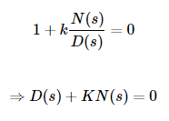
Where, K represents the multiplying factor
N(s) represents the numerator term having (factored) n^{th} order polynomial of ‘s’.
D(s) represents the denominator term having (factored) m^{th} order polynomial of ‘s’.
Substitute, G(s)H(s) value in the characteristic equation.
Case 1 K = 0
If K=0, then D(s)=0.
That means, the closed loop poles are equal to open loop poles when K is zero.
Case 2 K = ∞
Re-write the above characteristic equation as

Slide 10


Substitute, K=∞ in the above equation.
If K=∞, then N(s)=0. It means the closed loop poles are equal to the open loop zeros when K is infinity.
From above two cases, we can conclude that the root locus branches start at open loop poles and end at open loop zeros.

Slide 11
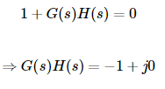
Angle Condition and Magnitude Condition
The points on the root locus branches satisfy the angle condition. So, the angle condition is used to know whether the point exist on root locus branch or not. We can find the value of K for the points on the root locus branches by using magnitude condition. So, we can use the magnitude condition for the points, and this satisfies the angle condition.
Characteristic equation of closed loop control system is

Slide 12


The phase angle of G(s)H(s) is
The angle condition is the point at which the angle of the open loop transfer function is an odd multiple of 180⁰.
Magnitude of G(s)H(s) is –
The magnitude condition is that the point (which satisfied the angle condition) at which the magnitude of the open loop transfer function is one.

Slide 13
Construction of Root Locus
The root locus is a graphical representation in s-domain and it is symmetrical about the real axis. Because the open loop poles and zeros exist in the s-domain having the values either as real or as complex conjugate pairs. In this chapter, let us discuss how to construct (draw) the root locus.
Rules for Construction of Root Locus
Follow these rules for constructing a root locus.
Rule 1 − Locate the open loop poles and zeros in the ‘s’ plane.

Slide 14

Rule 2 − Find the number of root locus branches.
We know that the root locus branches start at the open loop poles and end at open loop zeros. So, the number of root locus branches N is equal to the number of finite open loop poles P or the number of finite open loop zeros Z, whichever is greater.
Mathematically, we can write the number of root locus branches N as

Slide 15
Rule 3 − Identify and draw the real axis root locus branches.
If the angle of the open loop transfer function at a point is an odd multiple of 180⁰, then that point is on the root locus. If odd number of the open loop poles and zeros exist to the left side of a point on the real axis, then that point is on the root locus branch. Therefore, the branch of points which satisfies this condition is the real axis of the root locus branch.

Slide 16
Rule 4 − Find the centroid and the angle of asymptotes.
If P=Z, then all the root locus branches start at finite open loop poles and end at finite open loop zeros.
If P>Z , then Z number of root locus branches start at finite open loop poles and end at finite open loop zeros and P−Z number of root locus branches start at finite open loop poles and end at infinite open loop zeros.
If P<Z , then P number of root locus branches start at finite open loop poles and end at finite open loop zeros and Z−P number of root locus branches start at infinite open loop poles and end at finite open loop zeros.

Slide 17


So, some of the root locus branches approach infinity, when P≠Z. Asymptotes give the direction of these root locus branches. The intersection point of asymptotes on the real axis is known as centroid.
We can calculate the centroid α by using this formula,
The formula for the angle of asymptotes θ is
Where,
q=0,1,2,....,(P−Z)−1

Slide 18
Rule 5 − Find the intersection points of root locus branches with an imaginary axis.
We can calculate the point at which the root locus branch intersects the imaginary axis and the value of K at that point by using the Routh array method and special case (ii).
If all elements of any row of the Routh array are zero, then the root locus branch intersects the imaginary axis and vice-versa.
Identify the row in such a way that if we make the first element as zero, then the elements of the entire row are zero. Find the value of K for this combination.
Substitute this K value in the auxiliary equation. You will get the intersection point of the root locus branch with an imaginary axis.

Slide 19
Rule 6 − Find Break-away and Break-in points.
If there exists a real axis root locus branch between two open loop poles, then there will be a break-away point in between these two open loop poles.
If there exists a real axis root locus branch between two open loop zeros, then there will be a break-in point in between these two open loop zeros.

Slide 20
Note − Break-away and break-in points exist only on the real axis root locus branches.
Follow these steps to find break-away and break-in points.
Write K in terms of s from the characteristic equation 1+G(s)H(s)=0.
Differentiate K with respect to s and make it equal to zero. Substitute these values of s in the above equation.
The values of s for which the K value is positive are the break points.

Slide 21



Rule 7 − Find the angle of departure and the angle of arrival.
The Angle of departure and the angle of arrival can be calculated at complex conjugate open loop poles and complex conjugate open loop zeros respectively.
The formula for the angle of departure ϕd is
The formula for the angle of arrival ϕa is
Where

Slide 22

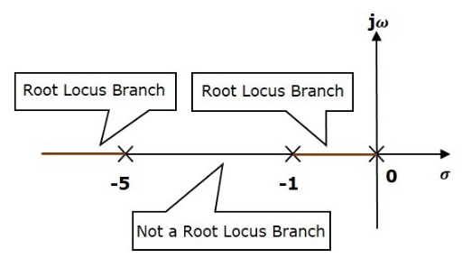
Example
Let us now draw the root locus of the control system having open loop transfer function,
Step 1 − The given open loop transfer function has three poles at s=0,s=−1, s=-5. It doesn’t have any zero. Therefore, the number of root locus branches is equal to the number of poles of the open loop transfer function.
N=P=3
The three poles are located are shown in the above figure. The line segment between s=−1and s=0 is one branch of root locus on real axis. And the other branch of the root locus on the real axis is the line segment to the left of s=−5.

Slide 23
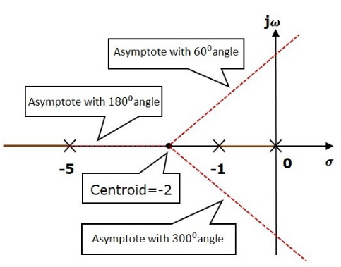
Step 2 − We will get the values of the centroid and the angle of asymptotes by using the given formulae.
Centroid α=−2
The angle of asymptotes are θ=60 deg, 180 deg and 300 deg.
The centroid and three asymptotes are shown in the following figure.

Slide 24
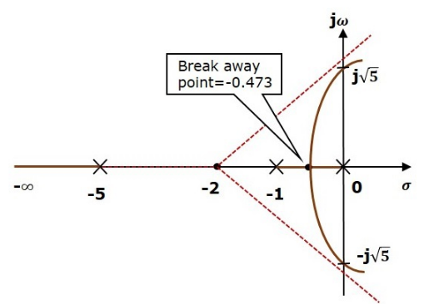
Step 3 − Since two asymptotes have the angles of 60 deg. and 300 deg., two root locus branches intersect the imaginary axis. By using the Routh array method and special case(ii), the root locus branches intersects the imaginary axis at j5 and –√j5.
There will be one break-away point on the real axis root locus branch between the poles s=−1 and s=0. By following the procedure given for the calculation of break-away point, we will get it as s=−0.473.
The root locus diagram for the given control system is shown in the following figure.

Slide 25
In this way, you can draw the root locus diagram of any control system and observe the movement of poles of the closed loop transfer function.
From the root locus diagrams, we can know the range of K values for different types of damping.

Slide 26
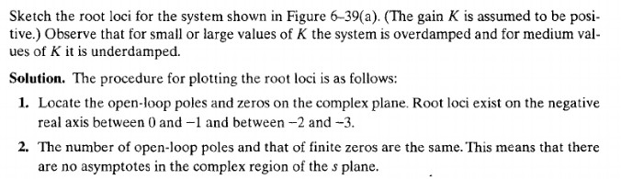
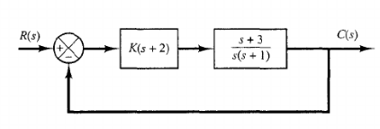

Slide 27
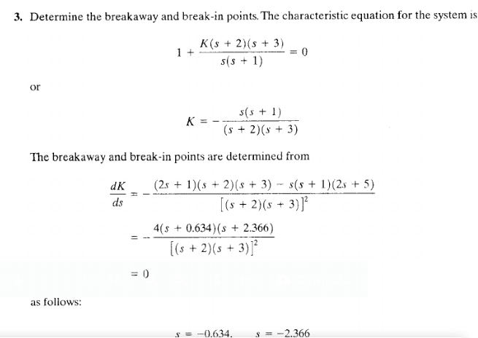
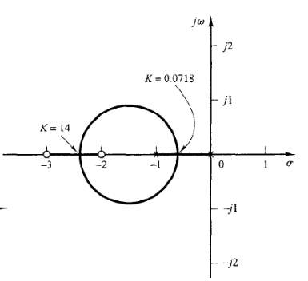

Slide 28
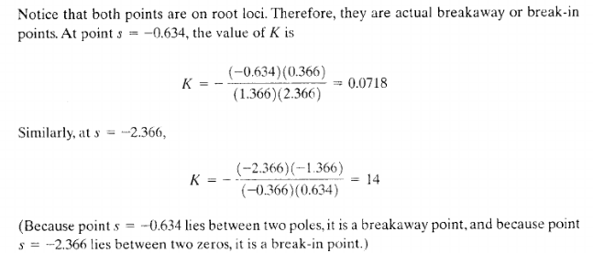

Slide 29
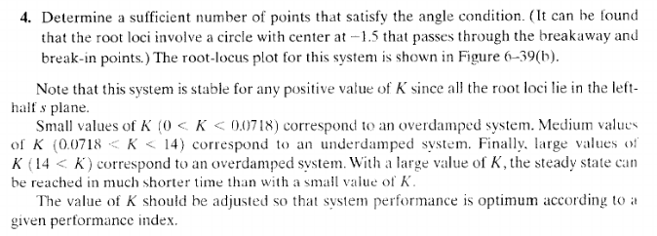

Slide 30
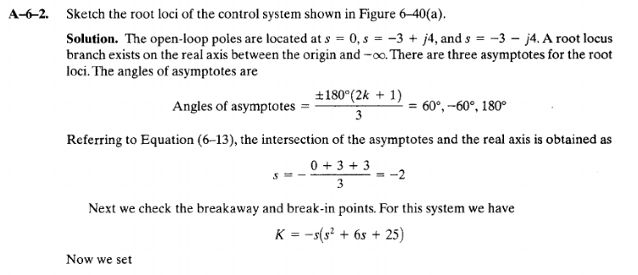
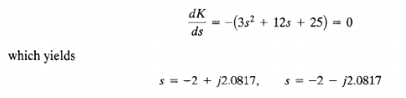
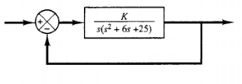

Slide 31
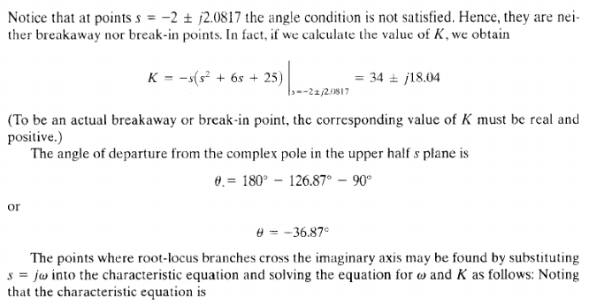
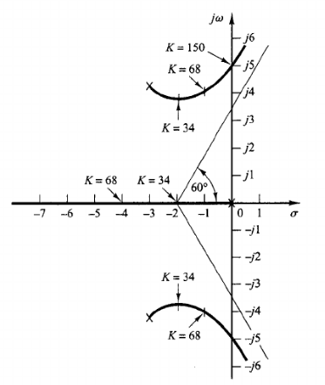

Slide 32
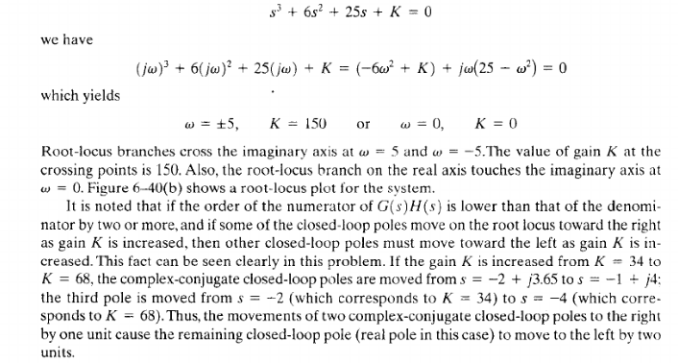

Slide 33
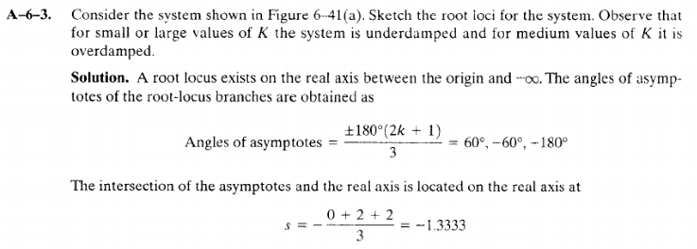


Slide 34
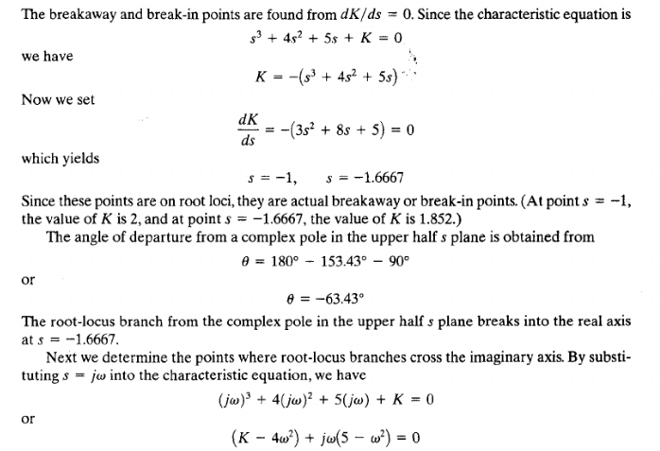
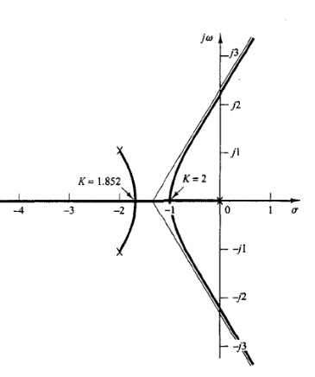

Slide 35
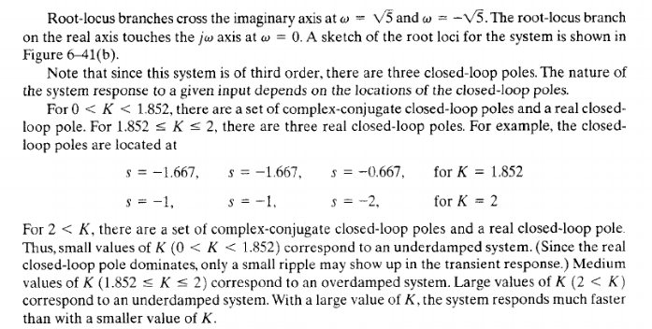

Slide 36
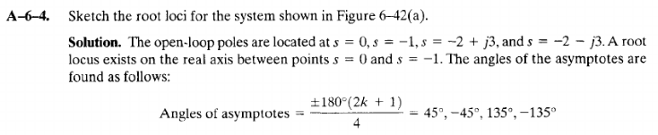
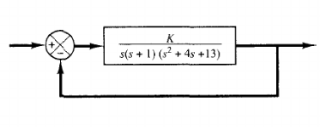

Slide 37
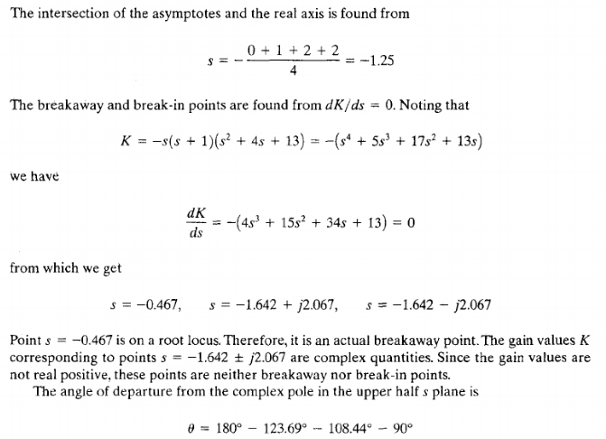
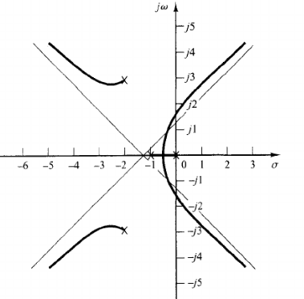

Slide 38
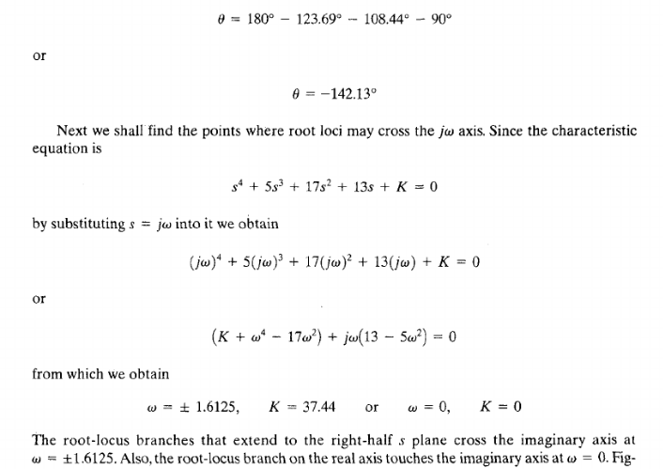


Slide 39
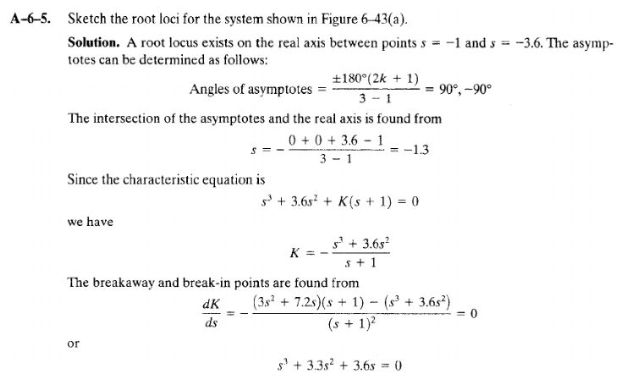
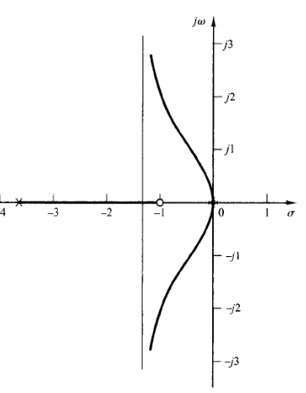
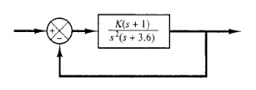

Slide 40
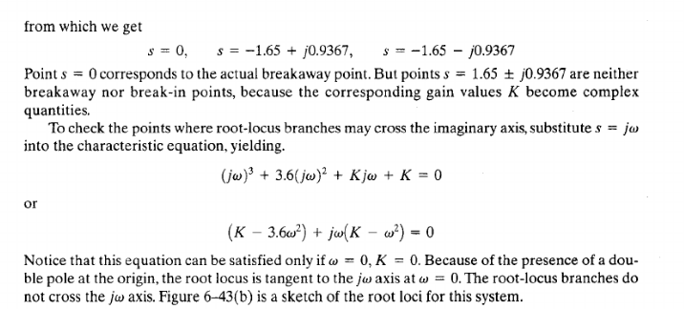

Slide 41
Effects of Adding Open Loop Poles and Zeros on Root Locus
The root locus can be shifted in ‘s’ plane by adding the open loop poles and the open loop zeros.
If we include a pole in the open loop transfer function, then some of root locus branches will move towards right half of ‘s’ plane. Because of this, the damping ratio δ decreases. Which implies, damped frequency ωd increases and the time domain specifications like delay time td, rise time tr and peak time tp decrease. But, it effects the system stability.
If we include a zero in the open loop transfer function, then some of root locus branches will move towards left half of ‘s’ plane. So, it will increase the control system stability. In this case, the damping ratio δ increases. Which implies, damped frequency ωd decreases and the time domain specifications like delay time td, rise time tr and peak time tp increase.

Slide 42

What is Frequency Response?
The response of a system can be partitioned into both the transient response and the steady state response. We can find the transient response by using Fourier integrals.
The steady state response of a system for an input sinusoidal signal is known as the frequency response.
If a sinusoidal signal is applied as an input to a Linear Time-Invariant (LTI) system, then it produces the steady state output, which is also a sinusoidal signal. The input and output sinusoidal signals have the same frequency, but different amplitudes and phase angles.
Let the input signal be

Slide 43




The open loop transfer function will be −
We can represent G(jω) in terms of magnitude and phase as shown below.
Substitute, ω=ω0 in the above equation.
The output signal is
The amplitude of the output sinusoidal signal is obtained by multiplying the amplitude of the input sinusoidal signal and the magnitude of G(jω) at ω=ω0.
The phase of the output sinusoidal signal is obtained by adding the phase of the input sinusoidal signal and the phase of G(jω) at ω=ω0

Slide 44

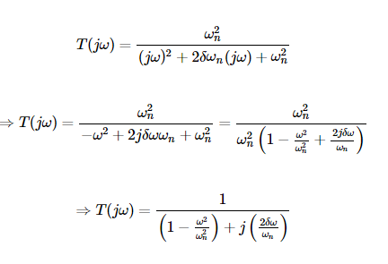
Frequency Domain Specifications
The frequency domain specifications are resonant peak, resonant frequency and bandwidth.
Consider the transfer function of the second order closed loop control system as,
Substitute, s=jω in the above equation.

Slide 45



Let, ω/ωn=u Substitute this value in the above equation.
Magnitude of T(jω) is –
Phase of T(jω) is –
Resonant Frequency
It is the frequency at which the magnitude of the frequency response has peak value for the first time. It is denoted by ωr. At ω=ωr, the first derivate of the magnitude of T(jω) is zero.

Slide 46
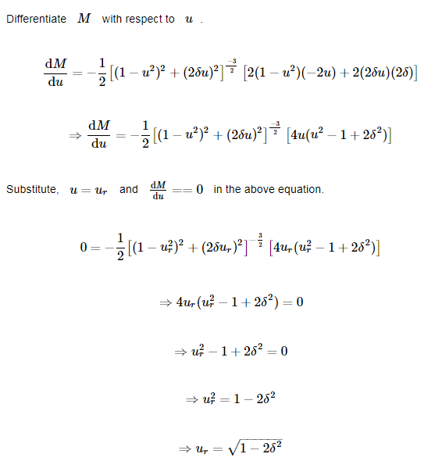

Slide 47
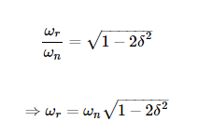
Substitute, ur=ωr/ωn in the above equation.

Slide 48
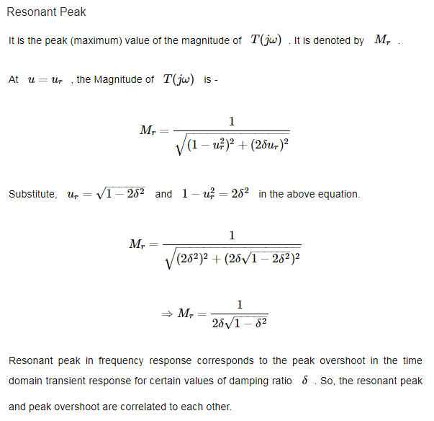

Slide 49
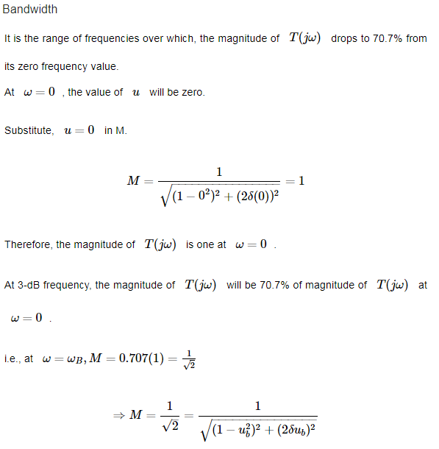

Slide 50
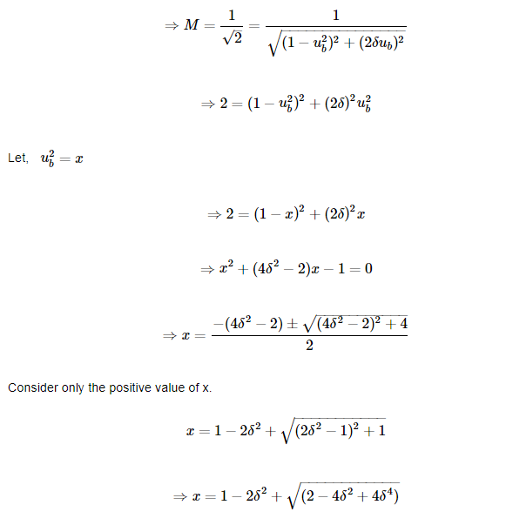

Slide 51
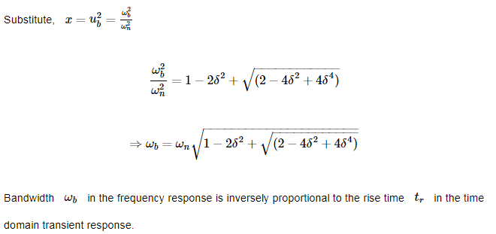

Slide 52


Bode Plot
The Bode plot or the Bode diagram consists of two plots −
Magnitude plot
Phase plot
In both the plots, x-axis represents angular frequency (logarithmic scale). Whereas, y axis represents the magnitude (linear scale) of open loop transfer function in the magnitude plot and the phase angle (linear scale) of the open loop transfer function in the phase plot.
The magnitude of the open loop transfer function in dB is –
The phase angle of the open loop transfer function in degrees is -

Slide 53
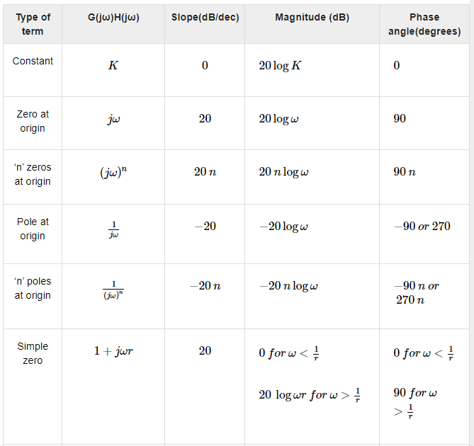

Slide 54
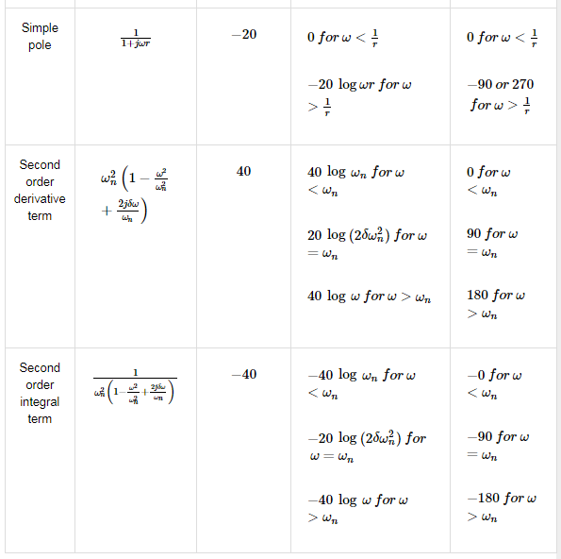

Slide 55
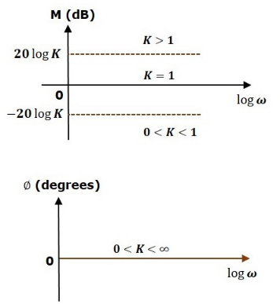
Consider the open loop transfer function G(s)H(s)=K.
Magnitude M=20 log K dB
Phase angle ϕ=0 degrees
If K=1, then magnitude is 0 dB.
If K>1, then magnitude will be positive.
If K<1, then magnitude will be negative.
The following figure shows the corresponding Bode plot.

Slide 56
The magnitude plot is a horizontal line, which is independent of frequency. The 0 dB line itself is the magnitude plot when the value of K is one. For the positive values of K, the horizontal line will shift 20 log K dB above the 0 dB line.
For the negative values of K, the horizontal line will shift 20 log K dB below the 0 dB line. The Zero degrees line itself is the phase plot for all the positive values of K.
Consider the open loop transfer function G(s) H(s) =s.
Magnitude M=20 log ω dB
Phase angle ϕ=90 deg.
At ω=0.1 rad/sec, the magnitude is -20 dB.
At ω=1 rad/sec, the magnitude is 0 dB.
At ω=10 rad/sec, the magnitude is 20 dB.
The following figure shows the corresponding Bode plot.

Slide 57
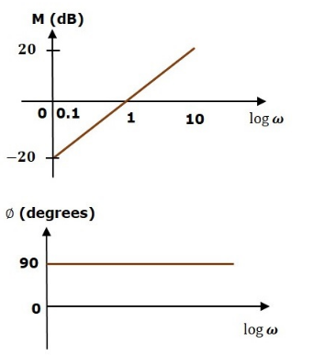
The magnitude plot is a line, which is having a slope of 20 dB/dec. This line started at ω=0.1 rad/sec having a magnitude of -20 dB and it continues on the same slope. It is touching 0 dB line at ω=1 rad/sec. In this case, the phase plot is 90⁰ line.

Slide 58



Consider the open loop transfer function G(s)H(s)=1+sτ.
Magnitude
Phase angle ϕ=tan−1 (ωτ) degrees
For , the magnitude is 0 dB and phase angle is 0 degrees.
For , the magnitude is 20log ωτ dB and phase angle is 90⁰.

Slide 59
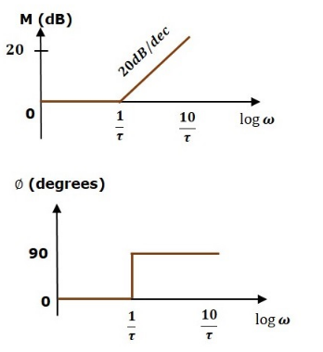
The magnitude plot is having magnitude of 0 dB upto ω=1/τ rad/sec. From ω=1/τ rad/sec, it is having a slope of 20 dB/dec. In this case, the phase plot is having phase angle of 0 degrees up to ω=1/τ rad/sec and from here, it is having phase angle of 90⁰. This Bode plot is called the asymptotic Bode plot.
As the magnitude and the phase plots are represented with straight lines, the Exact Bode plots resemble the asymptotic Bode plots. The only difference is that the Exact Bode plots will have simple curves instead of straight lines.

Slide 60
Rules for Construction of Bode Plots
Follow these rules while constructing a Bode plot.
Represent the open loop transfer function in the standard time constant form.
Substitute, s=jω in the above equation.
Find the corner frequencies and arrange them in ascending order.
Consider the starting frequency of the Bode plot as 1/10th of the minimum corner frequency or 0.1 rad/sec whichever is smaller value and draw the Bode plot up to 10 times maximum corner frequency.
Draw the magnitude plots for each term and combine these plots properly.
Draw the phase plots for each term and combine these plots properly.
Note − The corner frequency is the frequency at which there is a change in the slope of the magnitude plot.

Slide 61
Stability Analysis using Bode Plots
From the Bode plots, we can say whether the control system is stable, marginally stable or unstable based on the values of these parameters.
Gain cross over frequency and phase cross over frequency
Gain margin and phase margin
Phase Cross over Frequency
The frequency at which the phase plot is having the phase of -180⁰ is known as phase cross over frequency. It is denoted by ωpc. The unit of phase cross over frequency is rad/sec.

Slide 62
Gain Cross over Frequency
The frequency at which the magnitude plot is having the magnitude of zero dB is known as gain cross over frequency. It is denoted by ωgc. The unit of gain cross over frequency is rad/sec.
The stability of the control system based on the relation between the phase cross over frequency and the gain cross over frequency is listed below.
If the phase cross over frequency ωpc is greater than the gain cross over frequency ωgc, then the control system is stable.
If the phase cross over frequency ωpc is equal to the gain cross over frequency ωgc, then the control system is marginally stable.
If the phase cross over frequency ωpc is less than the gain cross over frequency ωgc, then the control system is unstable.

Slide 63
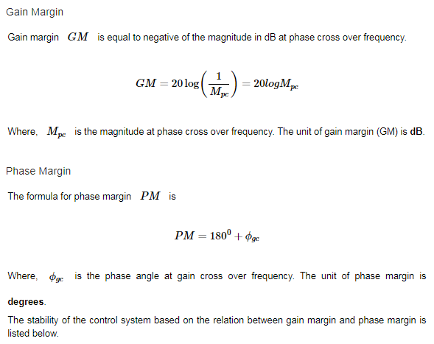

Slide 64
If both the gain margin GM and the phase margin PM are positive, then the control system is stable.
If both the gain margin GM and the phase margin PM are equal to zero, then the control system is marginally stable.
If the gain margin GM and / or the phase margin PM are/is negative, then the control system is unstable.

Slide 65
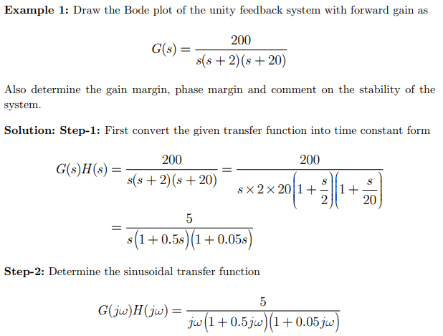


Slide 66
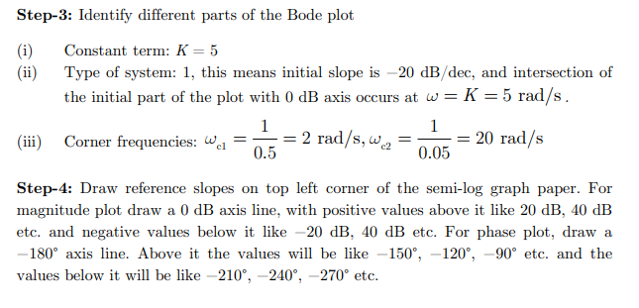

Slide 67
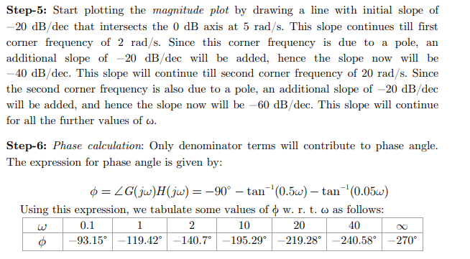

Slide 68
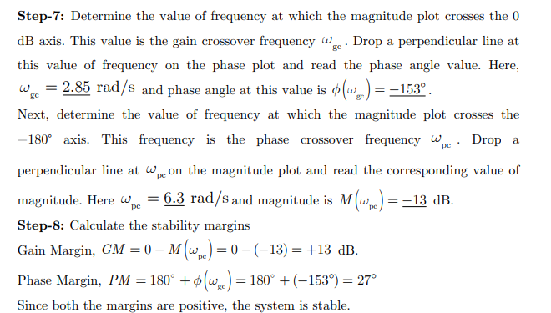

Slide 69
